Slide 1
pedestrian safety
Patrick McDevitt
Preeti Swaminathan
Joshua Herrera
02-Nov-2018
1
Notes:
<number>

Slide 2
Agenda
Problem statement
Solution method overview
Current situation
Data description
Model(s) construction
Results
Next Steps
1

Slide 3
Opportunity
Description of pedestrian safety as a concept
what is it
why it is interesting to pursue this project
what was motivation to involve with this
1

Slide 4
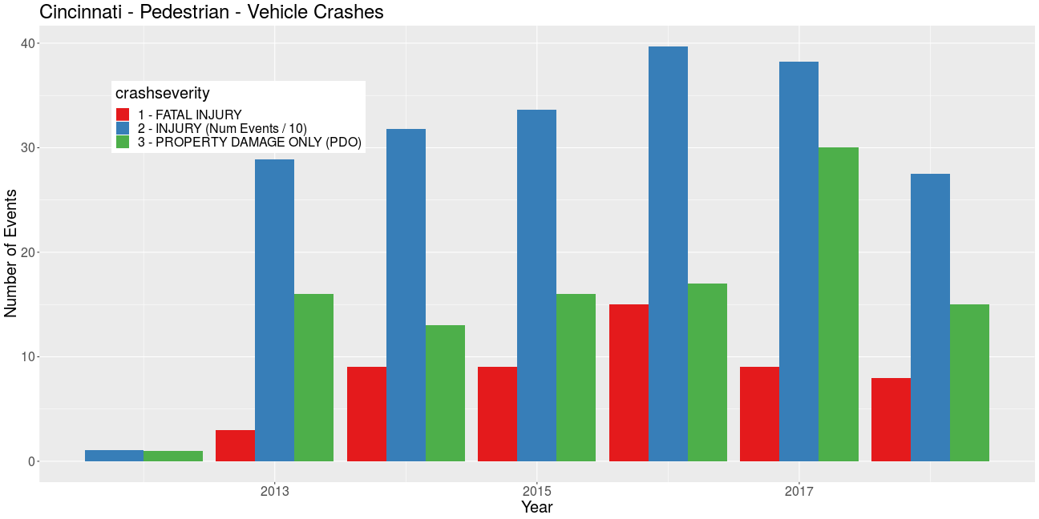
Cincinnati – pedestrian safety experience
add some comparative data vs. national averages
Fatalities : ~12 / year
Accidents w/ injuries : 350 / year
Total pedestrian involved accidents : 700 / year
1

Slide 5
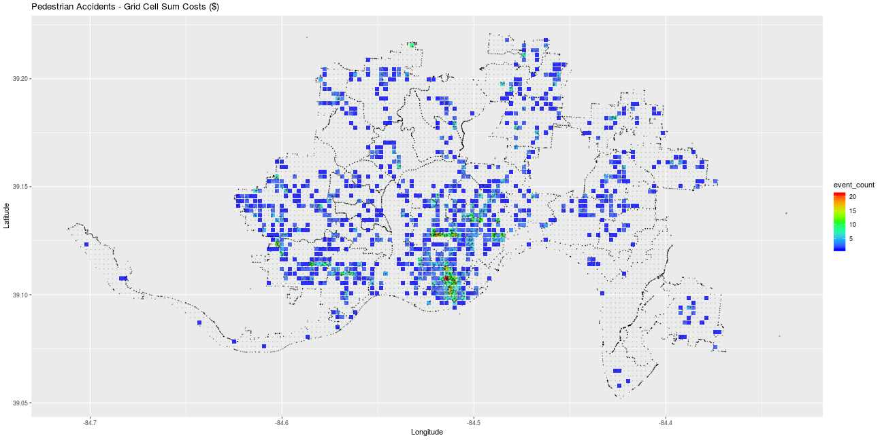
pedestrian accidents – locations / severity
Characteristics
widely dispersed across the city
heaviest concentration at city center & near east neighborhoods
National Safety Council estimated cost : $$$$$$

Slide 6
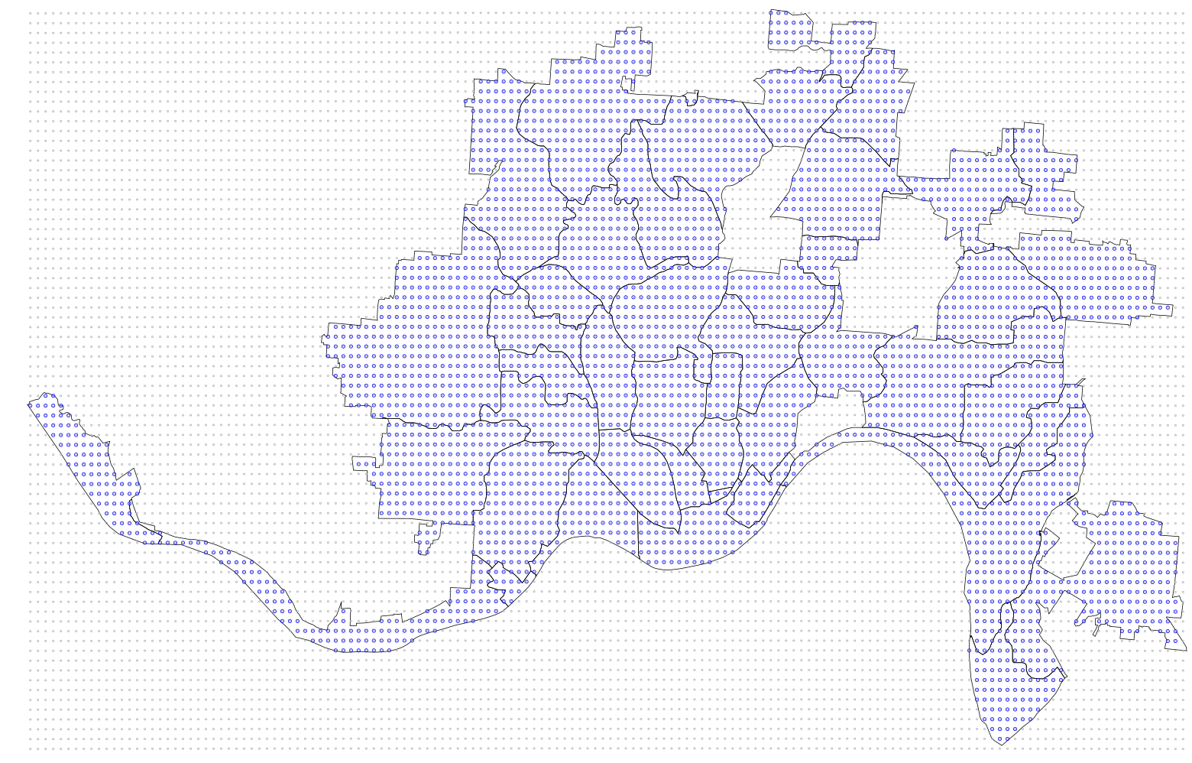
analysis method concept
Grid cell approach
accumulate experience of candidate features in each cell
grid cell size : 250m x 250m
uniform distribution, equidistant edges on earth surface
goldilocks grid size
4196 grid cells
(~80 sq-miles)
5

Slide 7
Model concept
Independent estimators
Non-pedestrian accidents
(cost, number)
Pedestrian survey responses
(category, number)
Reported near-misses
(location, number)
Street surface areas
(width, length, area)
Walk Scores
Fire incidents
(type, number)
Non-emergency service requests
(type, number)
Property values
(median sale values)
Pedestrian accidents
Cost factor = Sum(accidenti * severity)
(Response)
Pull the data from one representative cell and show all the elements that are contributing as candidate features in that cell
250m
250m

Slide 8
View of some data sets
5

Slide 9
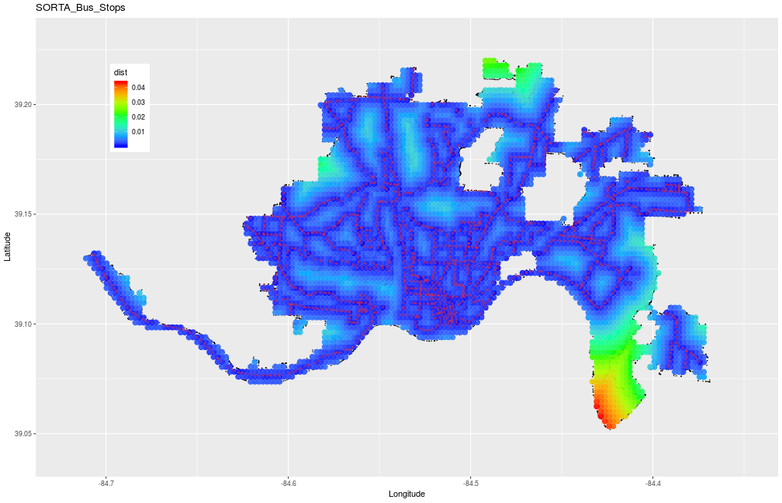
Bus stop localizations
Public transportation network : SORTA bus system
Distance to nearest bus stop in each grid cell

Slide 10
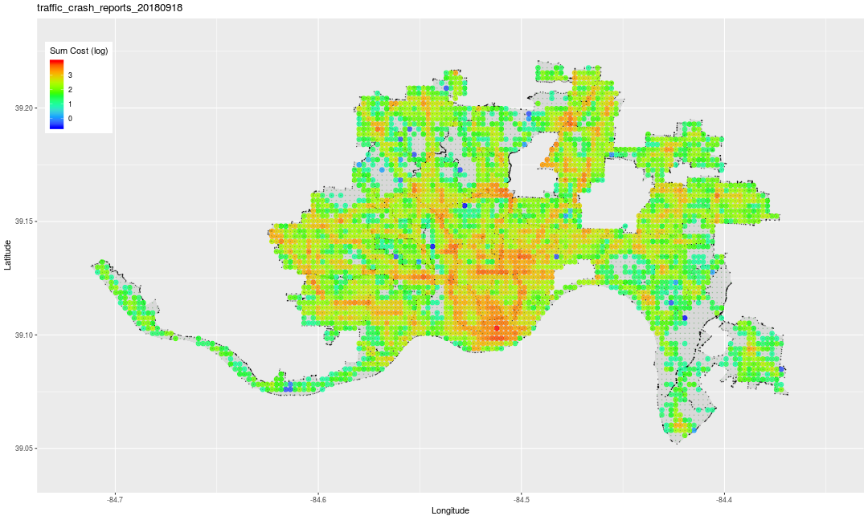
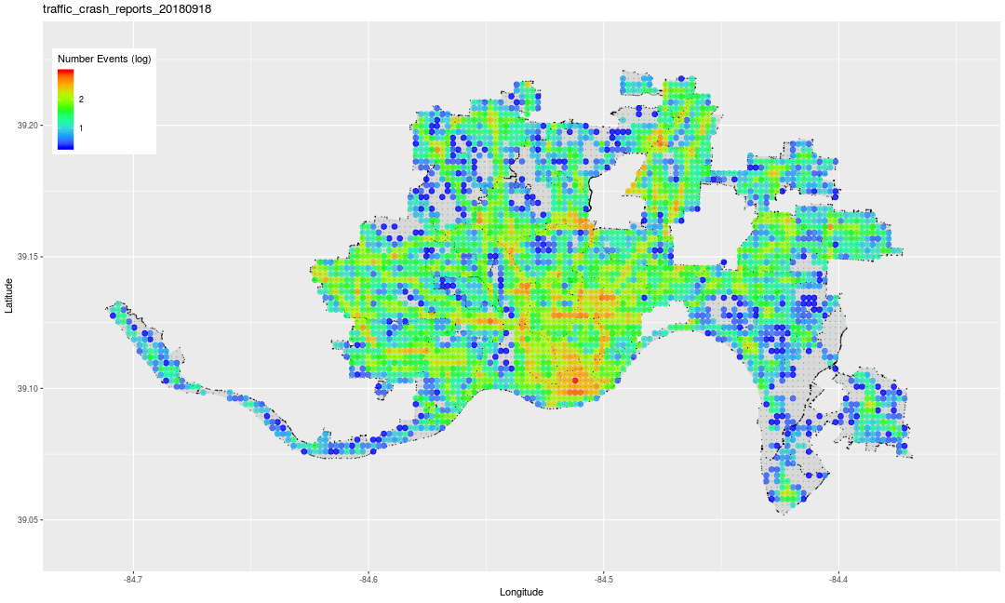
Traffic accidents – non-pedestrian
Costs (NSC model)
Accident density in grid cells
could add a bar chart to show some numeric information

Slide 11
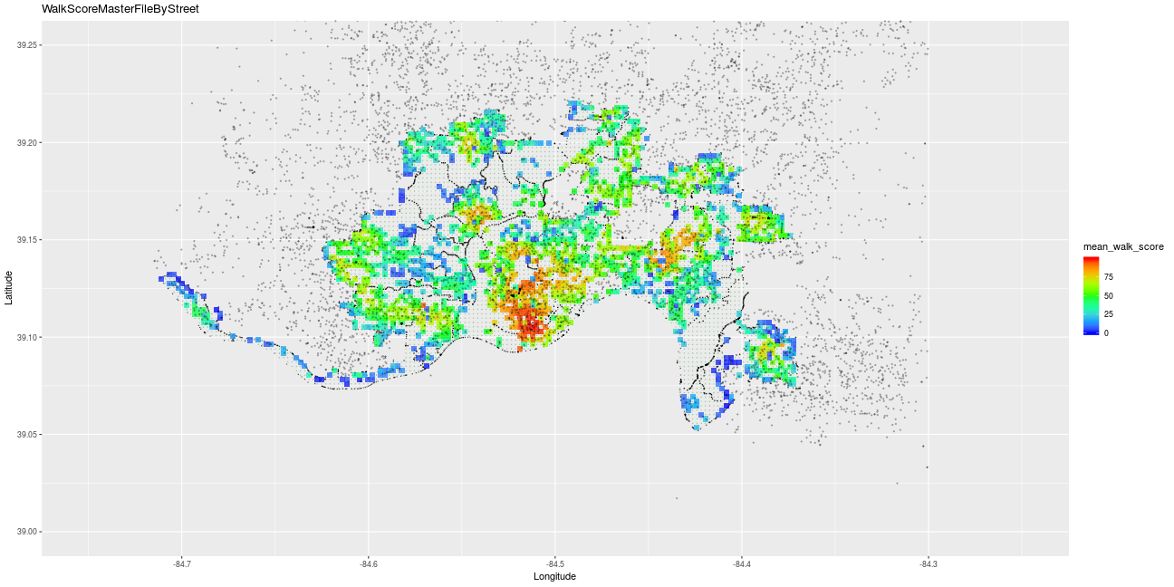
Walk Score®
high score (red)
low scores (blue)
Walk-ability
Add details about what contributes to higher / lower walk score

Slide 12
Feature Development
supplied features
derived features
12

Slide 13
Feature Development (3) – Events
13

Slide 14
Regression analysis
Josh .. add some model perspective / results
13

Slide 15
Regression analysis
13

Slide 16
Supervised learning – decision tree
13

Slide 17
Non-supervised learning - SOM
Objective :
Identify characteristics in ...
Preeti .. add some model perspective / results
13

Slide 18
Non-supervised learning
13

Slide 19
Non-supervised learning
13

Slide 20
Non-supervised learning
13

Slide 21
Summary
Features
developed range of features based on ...
Supervised learning
Some predictive capability – not excellent, but a good starting point
Consider additional supplementary data sources
Non-supervised learning
Initial patterns emerging to support understanding
re-visit after additional features incorporated in data set
13

Slide 22
Summary
13

Slide 23
Thank you &
safe commuting
13

Slide 24
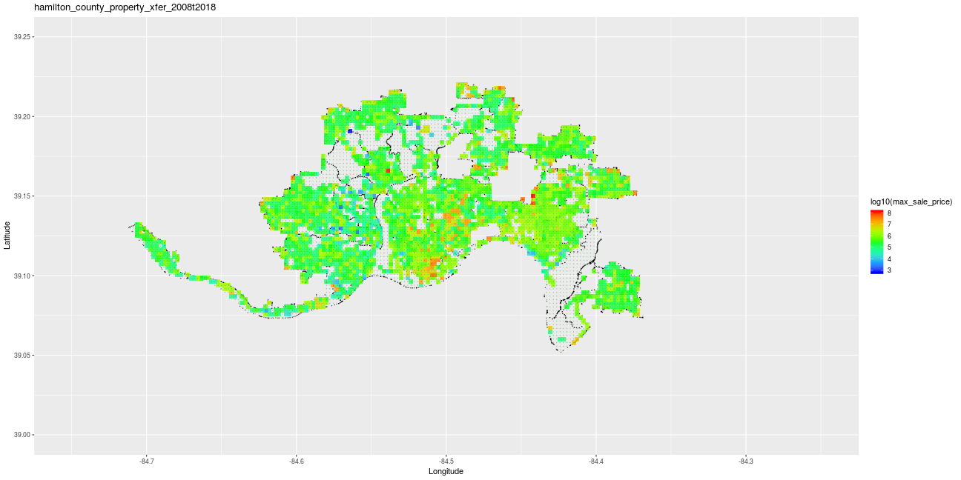

Slide 25
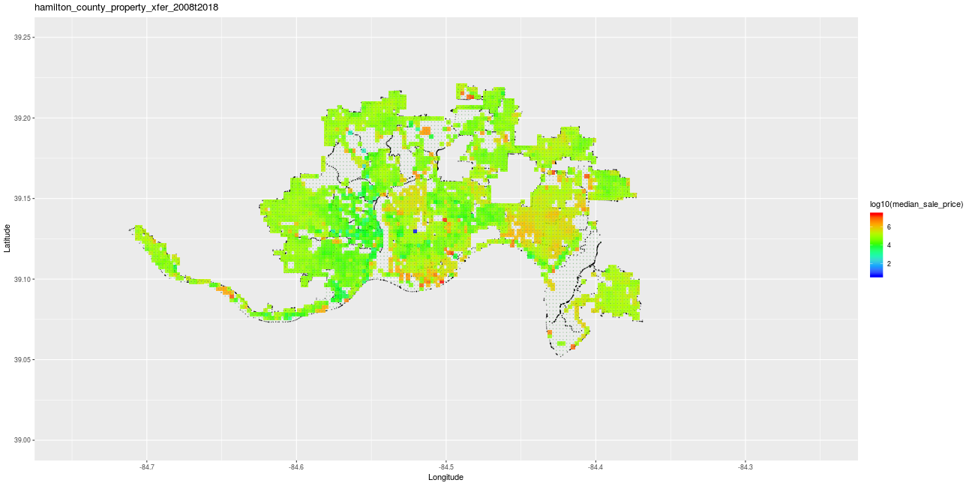

Slide 26
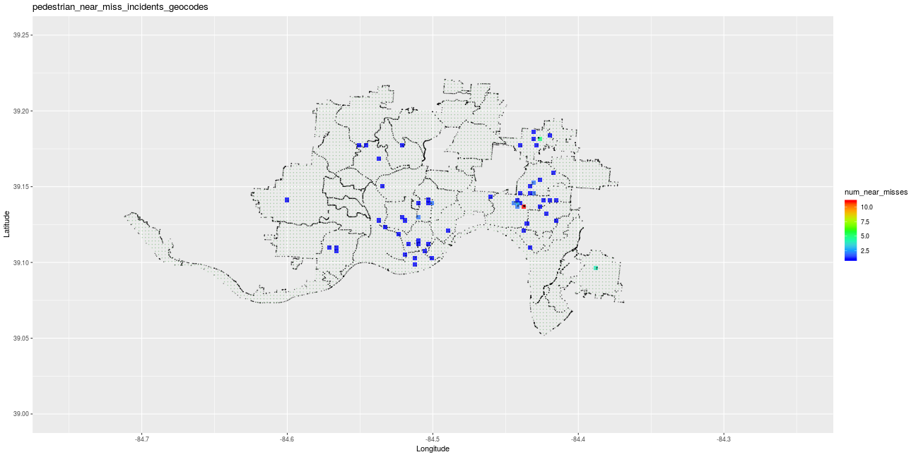

Slide 27
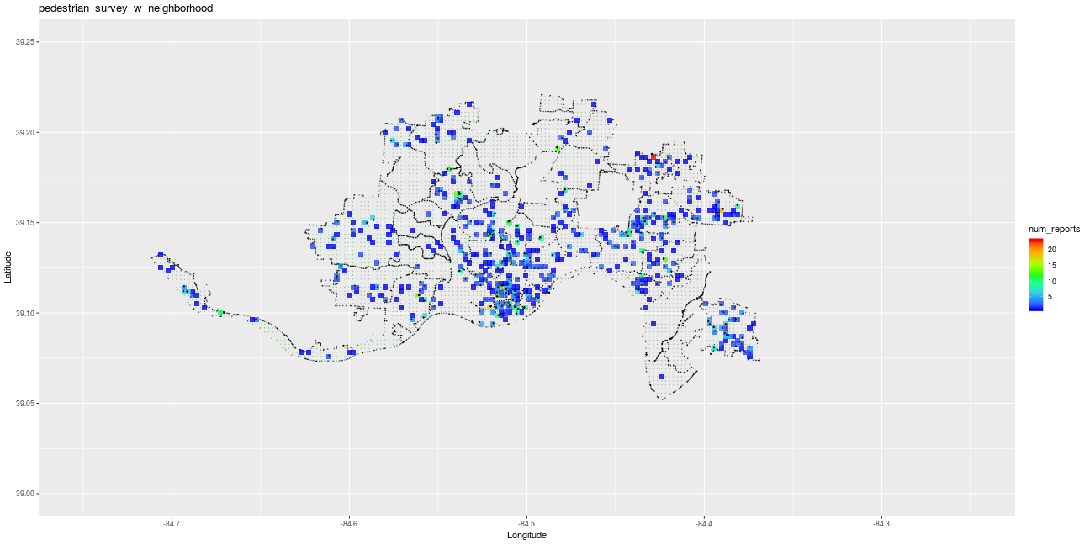

Slide 28


Slide 29
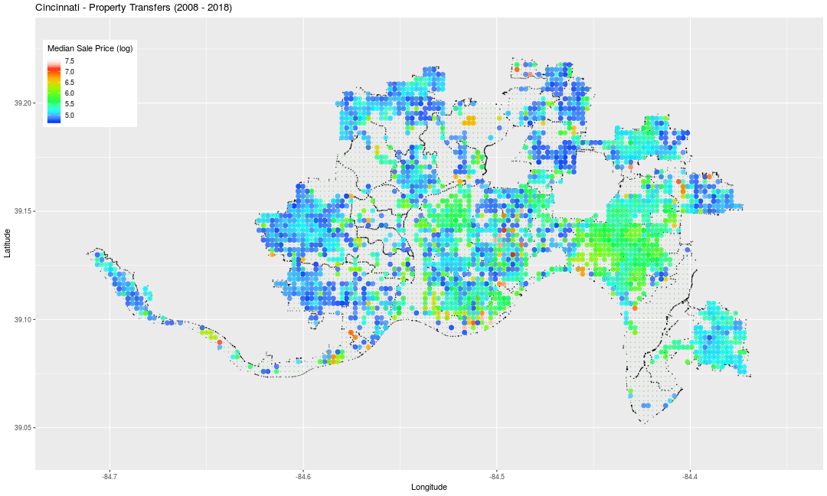

Slide 30
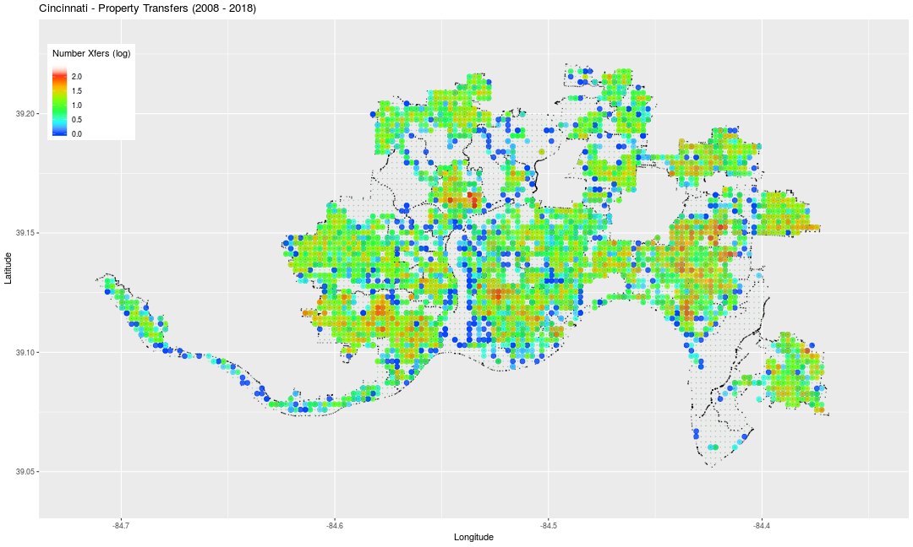
property xfers - qty

Slide 31
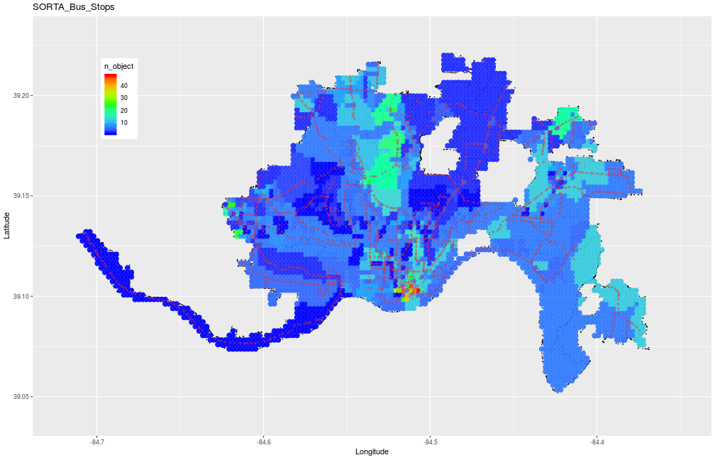
Bus stops

Slide 32
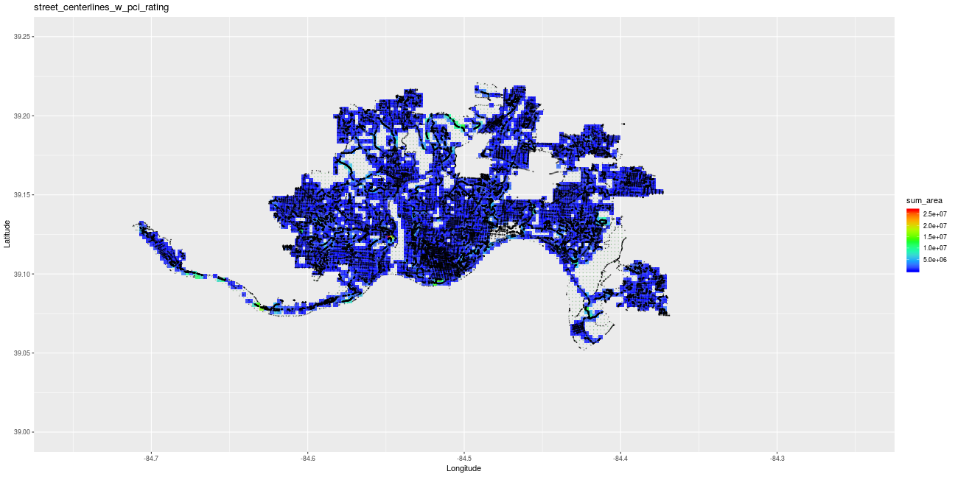

Slide 33
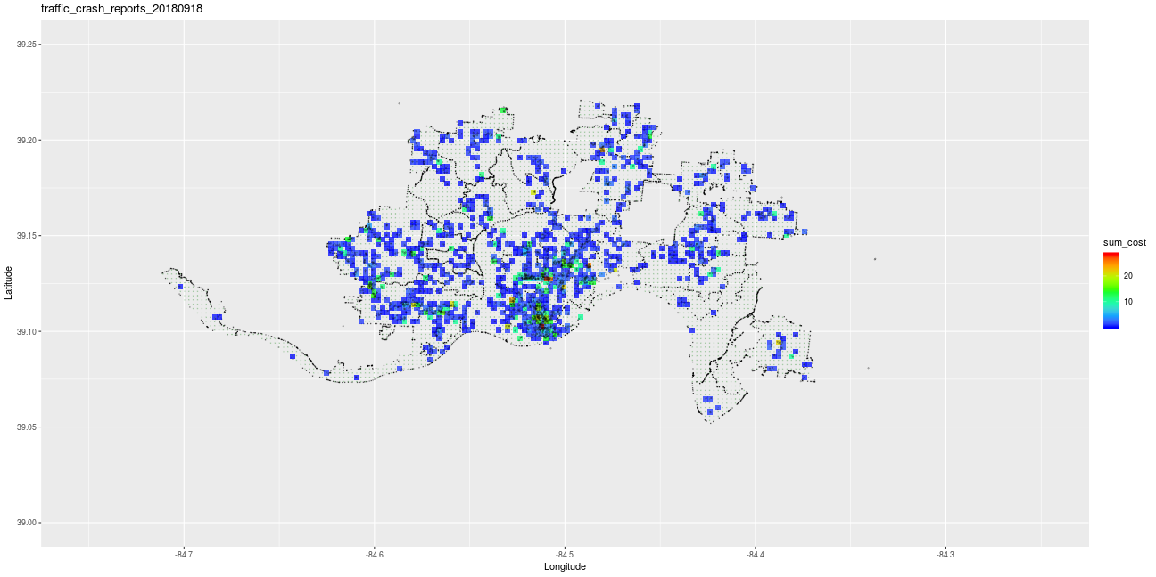

Slide 34
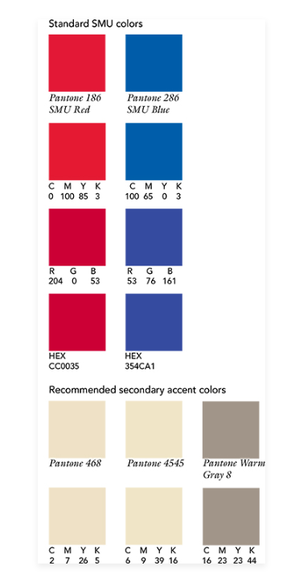
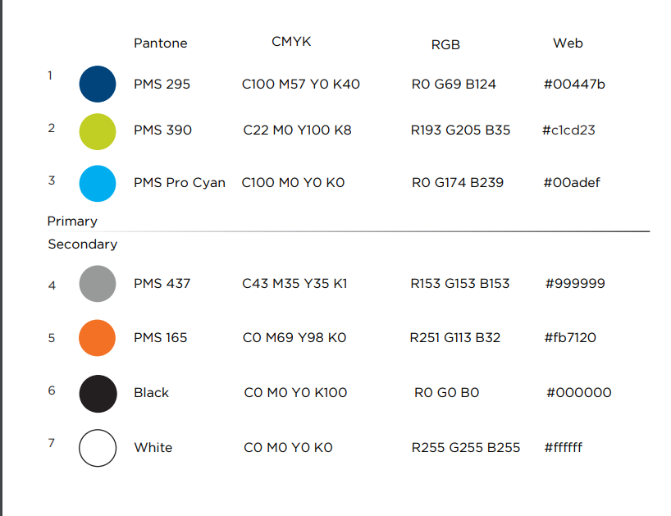
13

